Slide 1
Pseudocode

Slide 2
Some Programming Concepts
Flowcharts
A flowchart is a diagram that depicts a process, system or computer algorithm. They are widely used in multiple fields to document, study, plan, improve and communicate often complex processes in clear, easy-to-understand diagrams.
First design tool
Difficult to reflect programming
Pseudocode
Pseudocode is an informal way of programming description that does not require any strict programming language syntax or underlying technology considerations. It is used for creating an outline or a rough draft of a program. Pseudocode summarizes a program's flow but excludes underlying details.
New way of reflecting programming
More similar to actual programming
Can be difficult to follow if you’re new to it.

Slide 3
Pseudocode Rules
Like regular code – write one statement per line
Use CAPITALISATION and camelCasing where necessary
Indentation
This shows hierarchy and will get you used to programming
End multiline structures
Keep statements language independent
This is not a program, its plain English

Slide 4
Rule One: One Statement Per Line
Express just one action for the computer
An organised task list will correspond to a line of code
Task List
Read name, hours worked, rate of pay
Perform calculations
gross = hours worked * rate of pay
Write name, hours worked, gross
Pseudocode
READ name, hoursWorked, payRate
gross = hoursWorked * payRate
WRITE name, hoursWorked, gross

Slide 5
Rule Two: CAPITALISATION and camelCasing
Within Pseudocode you should remember to CAPITALISE your key words
This enables the reader to identify the functions being used
Where necessary also use camelCasing (or PascalCasing) to identify the name of a variable.
Some keyword examples include READ, WRITE, IF, ELSE, ENDIF, WHILE, ENDWHLE

Slide 6
Rule Two: CAPITALISATION and camelCasing
The following example provides evidence of CAPITALISATION and camelCasing
Pseudocode
READ name, hoursWorked, payRate
gross = hoursWorked * payRate
WRITE name, hoursWorked, gross

Slide 7
Rule Three: Indentation
Each design structure uses a particular indentation pattern
Indentation will make your pseudocode easier to read
It also prepares you for programming with Python
There’s a lot of indentation in Python ☺

Slide 8
Rule Three: Indentation
The rules of indentation include:
Sequence:
Keep statements in sequence all starting in the same column
Selection:
Indent statements that fall inside selection structure, but not the keywords that form the selection
Loop:
Indent statements that fall inside the loop but not keywords that form the loop

Slide 9
Rule Three: Indentation
Example Indentation:
READ name, grossPay, taxes
IF taxes > 0
net = grossPay – taxes
ELSE
net = grossPay
ENDIF
WRITE name, net

Slide 10
Rule Four: End Multiline Structures
When we look back to our Indentation example, you can see that the multiline structure is started with IF, provides varying results based on the condition with ELSE and ends with ENDIF.
This allows the reader to see when your methods end
The same rule applies for WHILE and ENDWHILE, FOR and ENDFOR etc…
This rule is commonly forgotten

Slide 11
Rule Five: Language Independence
As pseudocode is intended to be plain English you must resist the urge to write in the language you are studying or comfortable with.
If you write in plain English this will save you time.
The purpose of this is to enable you to describe a logic plan to develop a program, you are not actually programming it in python (or any other language).
Quite literally think “what is this line going to do?” and write it using the rules.

Slide 12
Pseudocode Structure and Flow Charts

Slide 13
Flowchart Legend
Flowcharts use special shapes to represent different types of actions or steps in a process.
Lines and arrows show the sequence of the steps, and the relationships among them.
These are known as flowchart symbols.
The type of diagram dictates the flowchart symbols that are used. For example, a data flow diagram may contain an Input/Output Symbol (also known as an I/O Symbol), but you wouldn't expect to see it in most process flow diagrams.

Slide 14
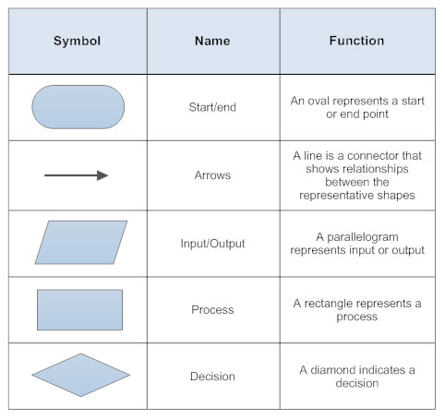
Flowchart Legend
Start/End: There should be a singular start and (generally) singular end in each diagram.
Arrows: Fairly self explanatory, must show correct direction, must be an arrow and not a line.
Input/Output: Sometimes referred to as the Data shape (e.g. in Visio). Show when data is being input to the system or output from the system (i.e. a user inputting their name, or a result/message being output to the user).
Process: Is the act of the system/program doing something (e.g. assigning a variable a value or doing a calculation).
Decision: A branching path in the flowchart which should only be a yes/no question with arrows that are labelled so show which path is for yes or no.

Slide 15
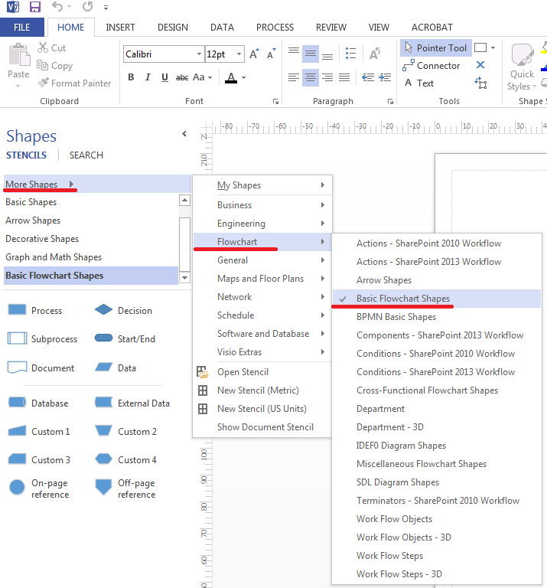
Visio flowcharts
SMTafe students have access to onthehub (generally from weeks 2-4 onwards, check your student emails!).
To set up visio to use flowchart shapes, see the diagram.

Slide 16
Structures
Throughout this section we are going to review the structures which you will use in pseudocode and your developed programs
To assist in your understanding I will also include the flow charts

Slide 17
Selection Structure
Selection is as simple as yes or no. Do we have an amount less than 100? If Yes we have an interest rate of .06, if no, we have an interest rate of .10.
In Pseudocode this looks something like:
IF amount < 100
interestRate = .06
ELSE
Interest Rate = .10
ENDIF

Slide 18
Selection Structure
If we look at the flow chart and the pseudocode – can you see the correspondence?
IF amount < 100
interestRate = .06
ELSE
InterestRate = .10
ENDIF
➔

Slide 19
Looping Structure
Loops can be a bit confusing especially when you attempt to depict looping in flow charts.
This is due to the use of the diamond as a control symbol
Thankfully pseudocode does not require a control symbol, and we can use specific keywords such as WHILE/ENDWHILE and REPEAT/UNTIL
Lets take a look at both of these.

Slide 20
Looping Structure: WHILE/ENDWHILE
count = 0
WHILE count < 10
ADD 1 to count
WRITE count
ENDWHILE
WRITE “The End”
Pseudocode
➔
Mainline
count = 0
WHILE count < 10
DO Process
ENDWHILE
WRITE “The End”
Process
ADD 1 to count
WRITE count
Modular
➔

Slide 21
Looping Structure: REPEAT/UNTIL
count = 0
REPEAT
ADD 1 to count
WRITE count
UNTIL count >= 10
WRITE “The End”
Pseudocode
➔
Mainline
count = 0
REPEAT
DO Process
UNTIL count >= 10
WRITE “The End”
Process
ADD 1 to count
WRITE count
Modular
➔

Slide 22
Comparing Pseudocode and Flowcharts
Flowchart Advantages:
UML Standardised(Unified Modeling Language)
Visual
Flowchart Disadvantages
Difficult to modify
No structured design elements
Generally require special software (e.g. Visio)
Pseudocode Advantages:
Easy to modify
Structured concepts
No special software requirement
Pseudocode Disadvantages
No visual (can be hard to follow)
No accepted standards (can vary between organisations)

Slide 23
Data, Variables, Calculation and Selection

Slide 24
How to Show Data Access
In pseudocode, we still need to show the access and transition of data. This can be achieved with the READ statement
READ depicts us telling the computer to get a value from an input device and store it in a memory location.

Slide 25
Memory Locations
These are identified by their addresses
They are generally given names such as field names or variable names
These names must use descriptive words such as TCPPort instead of the actual port number 1024

Slide 26
Variables
Used to store information to be referenced and used by programs
Provide a means of labelling data with a descriptive name
Also have their own unique set of rules

Slide 27
Variable Rules
Begin with lowercase letters or camelCasing/PascalCasing
Additional words must begin with a capital
Contain no spaces
Unique names within code and no use of keywords
Consistent use of names
E.G. myName, myAge, myGender, myAddress

Slide 28
Fields: Calculation and Selection
Calculations
+ Add
Subtract
* Multiply / Divide ** or ^ Exponential ( ) grouping
Selection
> Greater than
< Less than
= Equal to
>= Greater than or equal to
<= Less than or equal to
<> Not equal to

Slide 29


Questions?

